Slide 1
enlight
An optimized raycasting approach for subtractive manufacturing simulation and visualization

Slide 2
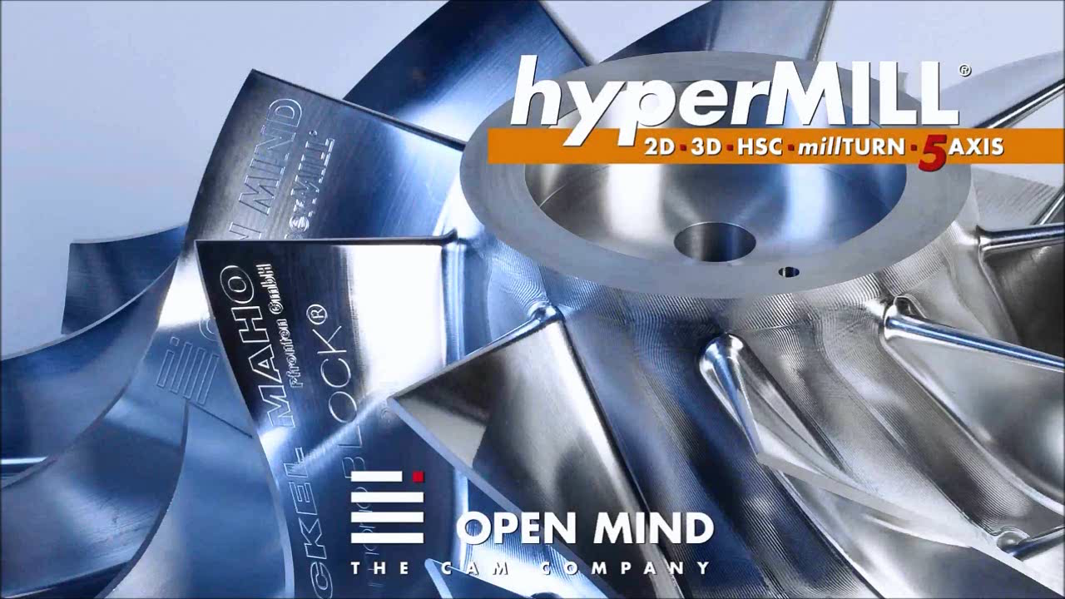
Milling - Subtractive manufacturing
Adapted from: https://www.youtube.com/watch?v=P0ImcDi_B0o

Slide 3
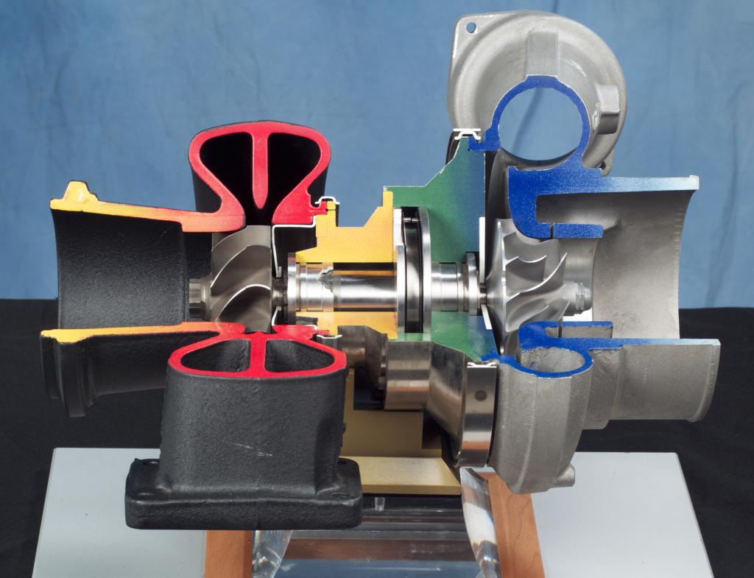
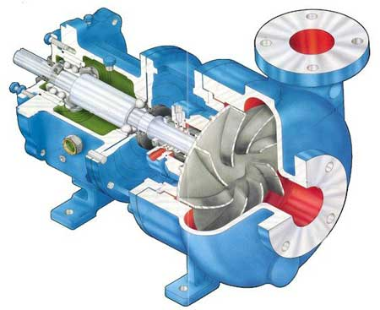
Impeller
http://en.wikipedia.org/wiki/File:Turbocharger.jpg
http://www.globalpumps.in/matherplatt.html

Slide 4
Overview

Slide 5
Digital simulation

Slide 6
3D imaging

Slide 7
Rasterization

Slide 8
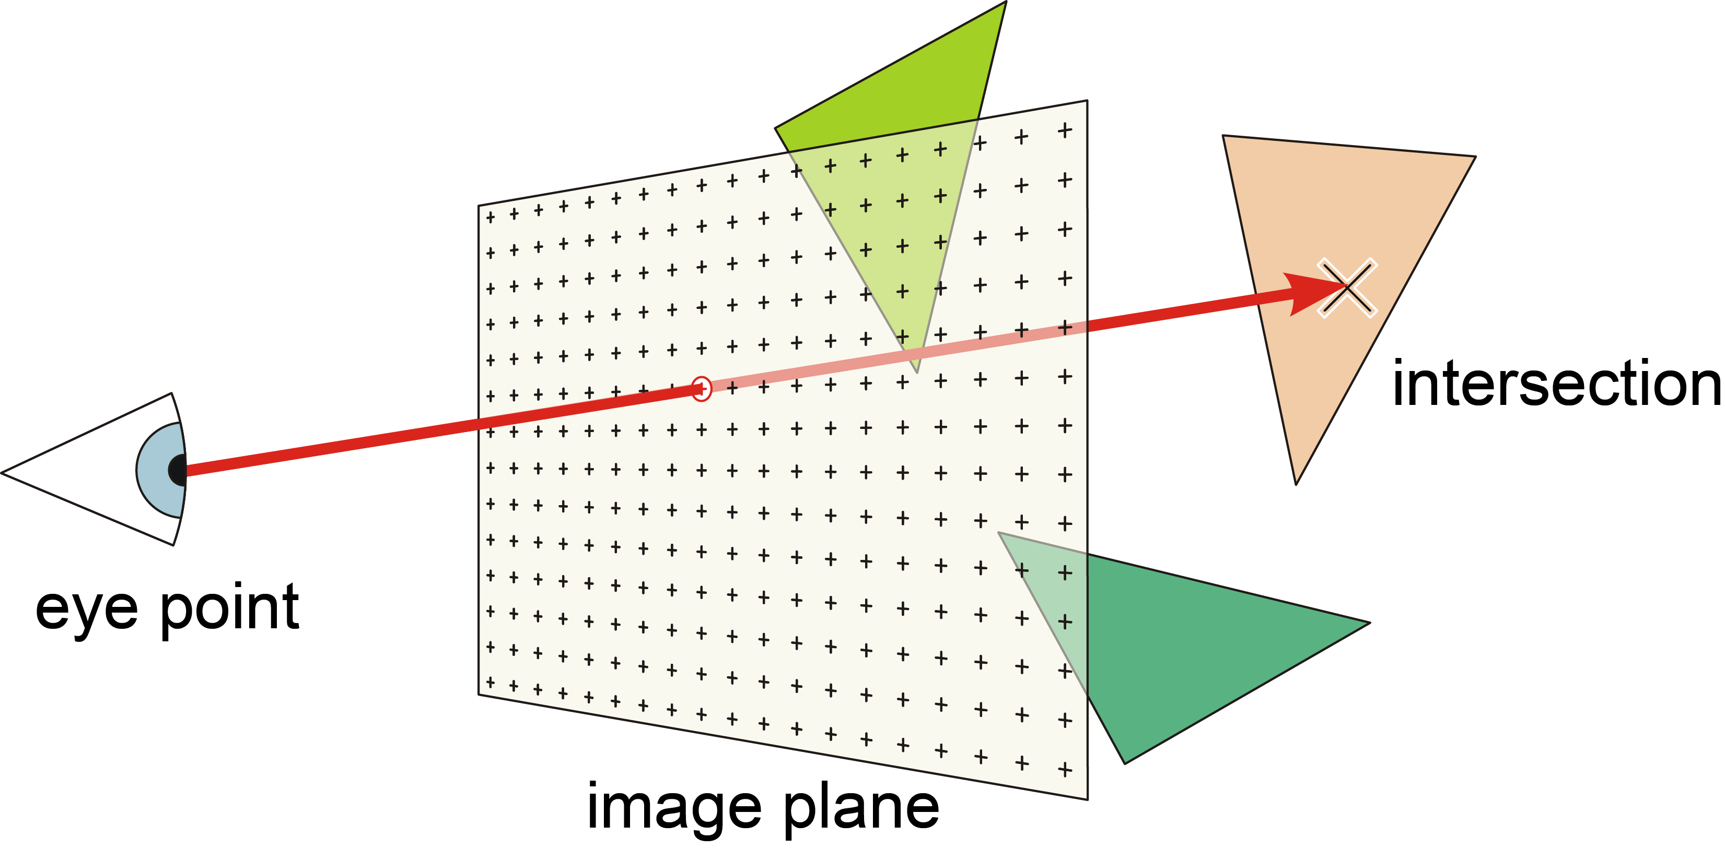
Raycasting

Slide 9
Swept volumes - entry/exit counting

Slide 10
Triangle intersection

Slide 11
OpenGL integration - Composition

Slide 12
OpenGL integration - Retriangulation

Slide 13
Acceleration
Trees
Grids

Slide 14
Regular grid

Slide 15
Traversal

Slide 16
Optimizing triangle count

Slide 17
Cell classification

Slide 18
Open volumes

Slide 19
Triangle reduction

Slide 20
Vectorization and memory locality

Slide 21
Packet casting

Slide 22
GPU Acceleration

Slide 24
Master thesis

